Slide 1
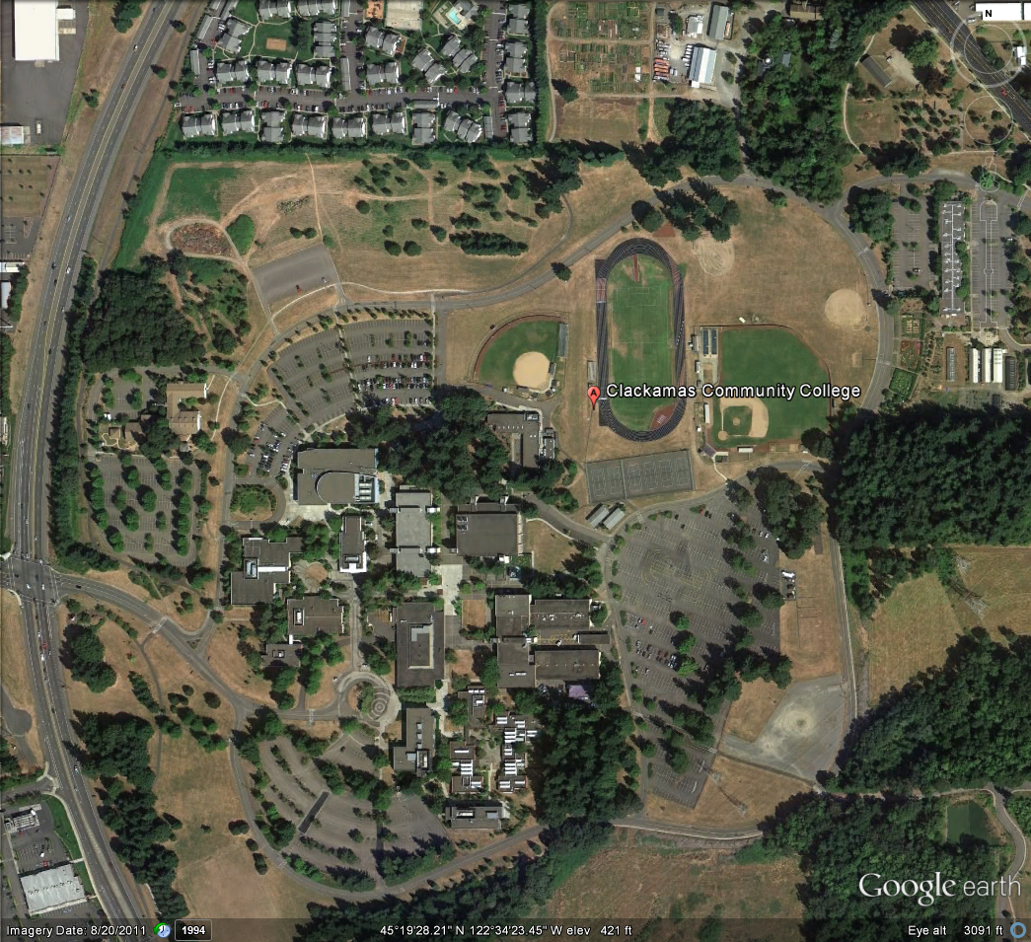
Existing Smoking Shelter Locations

Slide 2
Barlow Relocation

Slide 3
Poet’s Chair Relocation

Slide 4
Gregory Forum Removal

Slide 5
Dye-Streeter Removal

Slide 6
Niemeyer Modification

Slide 7
Roger Rook Relocation

Slide 8
Final Phase 1 – Smoking Shelter Locations

Slide 9
Final Phase 1 – Smoking Shelter Locations

